Slide 1
A Tutorial on Neural Architecture Search
IEEE ICDM 2019 Tutorials on Automated Deep Learning: Theory, Algorithms, Platforms, and Applications
Nov. 09, 2019
Speaker: Dr. Siyu Huang
Big Data Lab, Baidu Research, Beijing

Slide 2

Siyu Huang (黄思羽)
Research Scientist at Big Data Lab, Baidu Research
Research Interests: Neural Architecture Search, Generative Model, Multi-Modal Analysis
Ph.D. at College of Information Science and Electronic Engineering, Zhejiang University, China
Sept 2014 - July 2019
Supervised by Prof. Zhongfei (Mark) Zhang and Prof. Xi Li
Visiting Scholar at Language Technologies Institute, School of Computer Science, Carnegie Mellon University, USA
Jan 2018 - Jan 2019
Supervised by Prof. Alexander G. Hauptmann.
Bachelor at College of Information Science and Electronic Engineering, Zhejiang University, China
Sept 2010 - June 2014
Chu Kochen Honors College

Slide 3
Goal of This Tutorial: A Brief Overview of NAS
AutoDL and NAS
NAS with RL
NAS with RL
NAS-Net
Weight sharing mechanism
Our work: Adaptive cross-domain NAS
Our work: AutoGAN
Differentiable NAS
Architecture embedding method
Continuous relaxation of discrete architecture
Our work: NAS-based state-of-the-art image classification model
Our work: Resource-customized NAS
Greedy NAS
Our work: NAS for tree-topology network

Slide 4


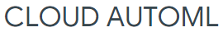

Automated Deep Learning (AutoDL)
AutoDL: Automation of DL Pipelines
Accelerate DL research and industrial applications
Benefit communities other than DL professionals Efficiently
AutoDL includes
Automated data preprocessing and cleansing
Automated model selection
Automated hyperparameter optimization
Neural architecture search
……

Slide 5
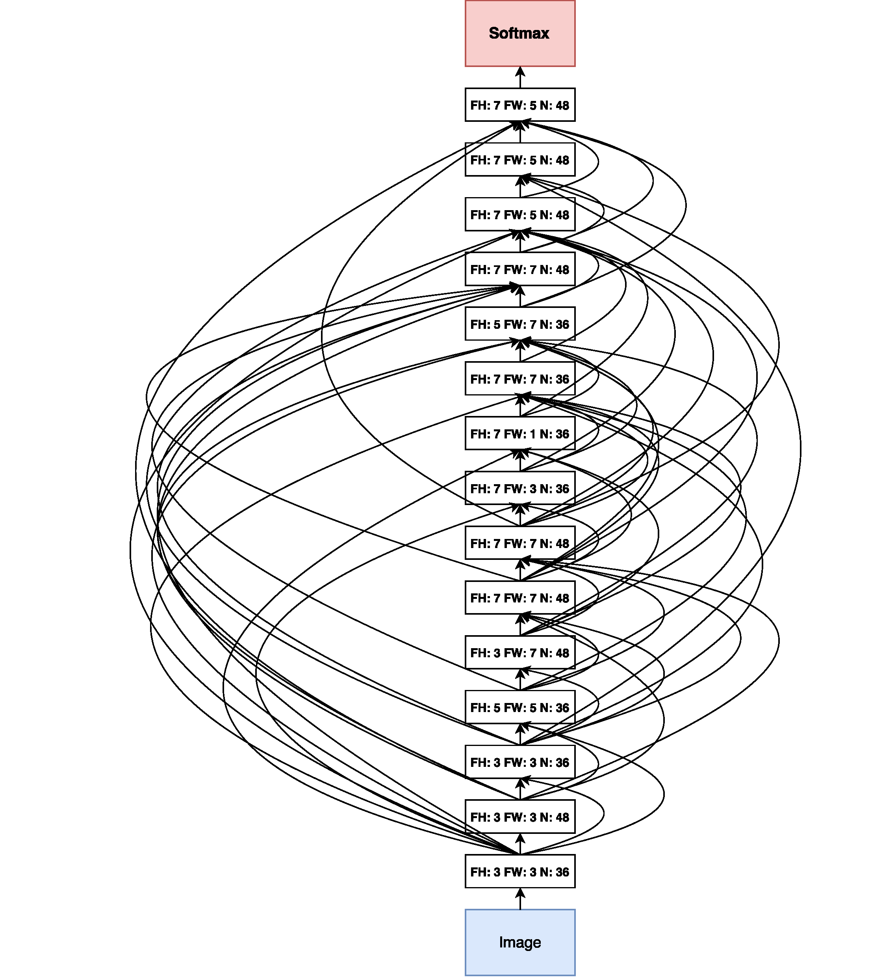
Neural Architecture Search (NAS)
NAS: The automated design of neural network architectures
Expensive black-box optimization problem
Current mainstream NAS methods:
Random/Grid Search
Bayesian Optimization (BO)
Evolutionary Algorithm (EA)
Reinforcement Learning (RL)
Differentiable NAS
Zoph and Le, ICLR’17

Slide 6
Goal of This Tutorial: A Brief Overview of NAS
AutoDL and NAS
NAS with RL
NAS with RL
NAS-Net
Weight sharing mechanism
Our work: Adaptive cross-domain NAS
Our work: AutoGAN
Differentiable NAS
Architecture embedding method
Continuous relaxation of discrete architecture
Our work: NAS-based state-of-the-art image classification model
Our work: Resource-customized NAS
Greedy NAS
Our work: NAS for tree-topology network

Slide 7
NAS with RL & Differentiable NAS
Gradient-based
Policy Gradient
RL
∂ performance
∂ arch
continuous relaxation
DARTS
arch embedding
NAO

Slide 8
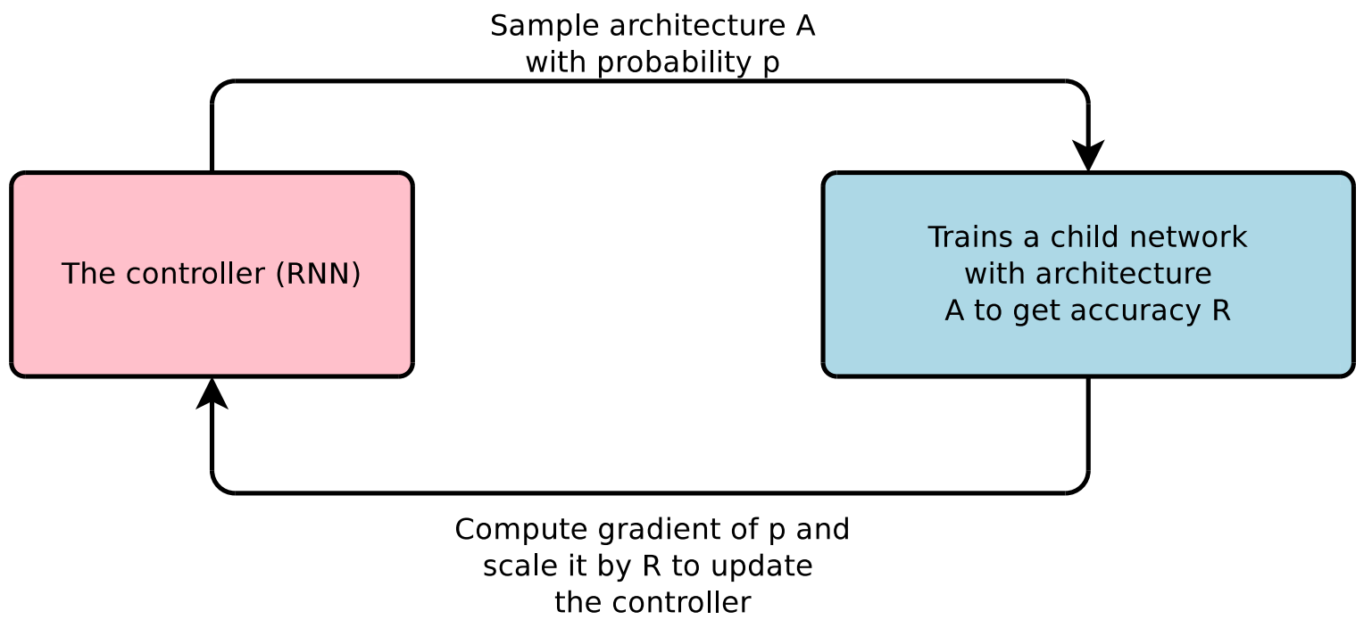
NAS with RL - Basic Procedure
1. Sample candidate architectures with a Controller.
2. Train candidate architectures on a specific task and evaluate the performances on validation set as rewards for the candidates.
3. Update Controller based on rewards.
Zoph and Le, ICLR’17

Slide 9
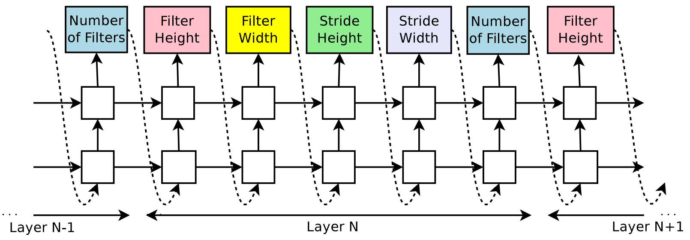
NAS with RL - Controller
Controller (RNN)
Zoph and Le, ICLR’17

Slide 10
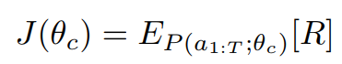
NAS with RL - The Optimization of Controller
Objective：Maximize architecture’s validation performance R.

Slide 11
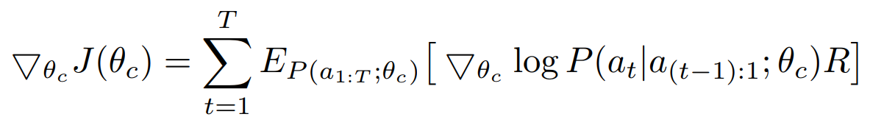
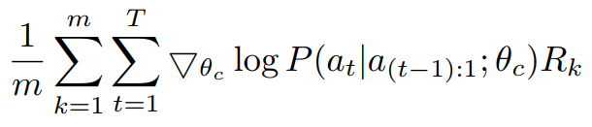
NAS with RL - The Optimization of Controller
Objective：Maximize architecture’s validation performance R.
R is not differentiable w.r.t. archs. We introduce Policy Gradient (REINFORCE) to update Controller.
≈

Slide 12
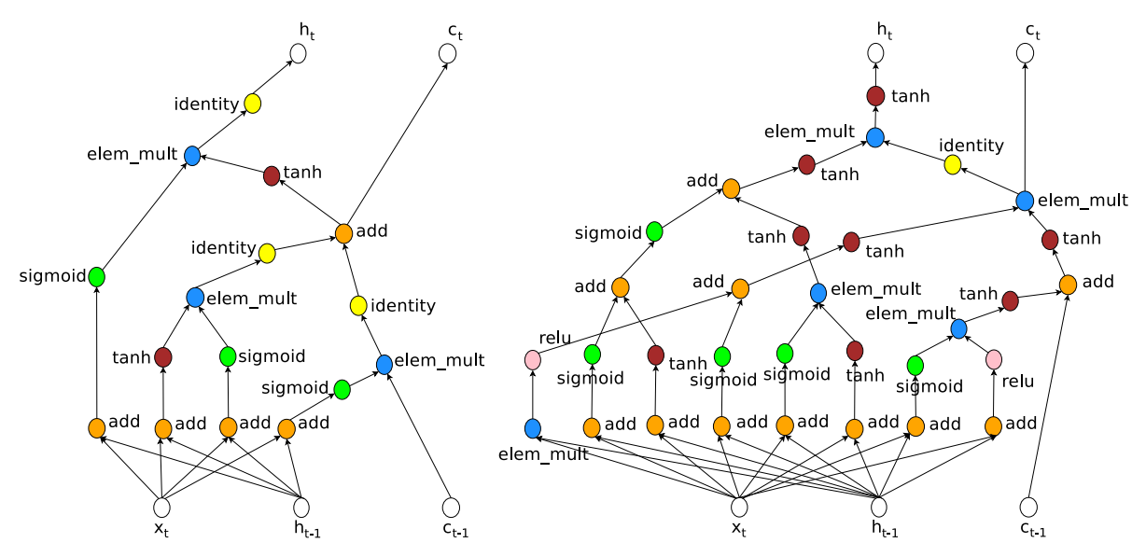
NAS with RL - NAS outperforms handcrafted archs for the first time - Language model (Penn Treebank dataset)
LSTM Cell
NAS Cell
RNN Cells
Zoph and Le, ICLR’17

Slide 13
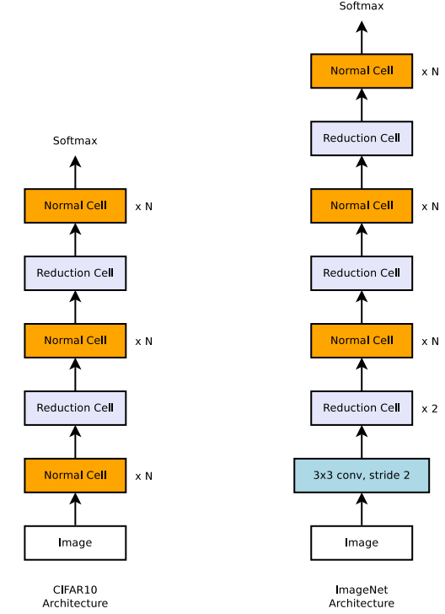
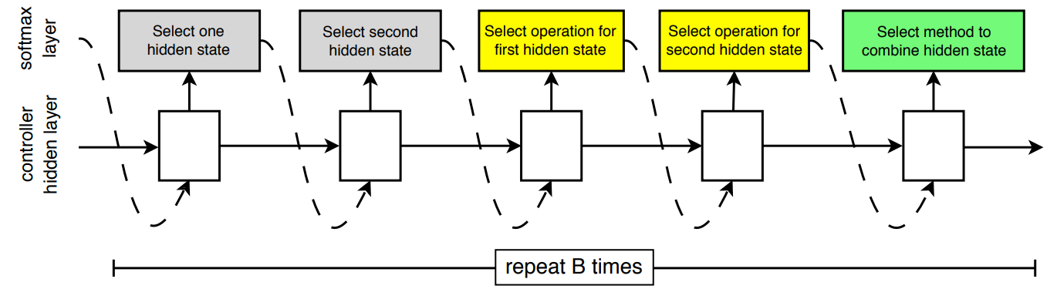
NAS with RL - NAS-Net (Zoph et al. CVPR’18)
Discovering Archs in a Convolutional Cell
Introduce Normal Cell and Reduction Cell
Normal Cell: Same feature map size between input and output
Reduction Cell: Output has smaller feature map size but more filters

Slide 14
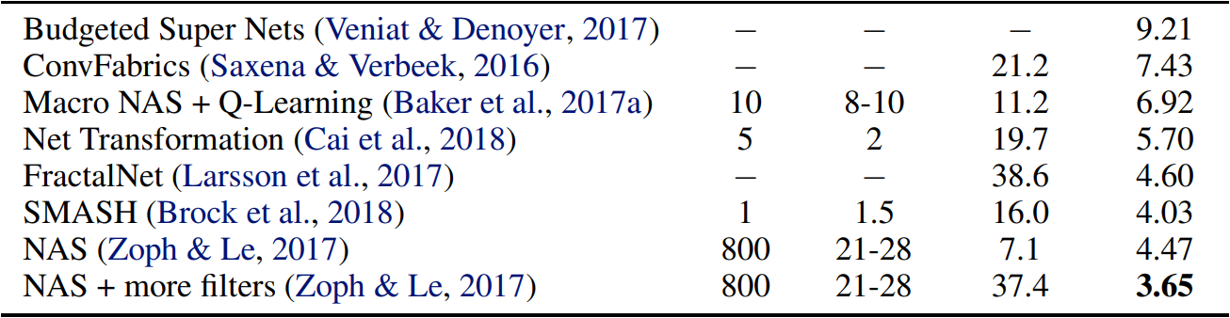
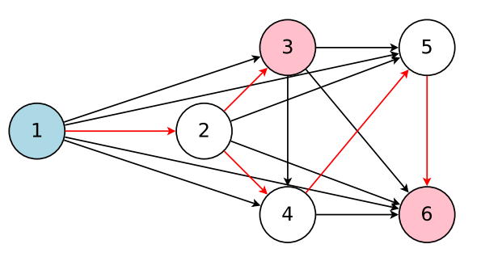
NAS with RL - Weight Sharing Mechanism (Pham et al. ICML’18)
Weight Sharing Mechanism
All candidates belong to one hyper-graph (DAG)
Build candidates by activating paths of hyper-graph
Neural weights shared between candidates
Huge computing cost

Slide 15
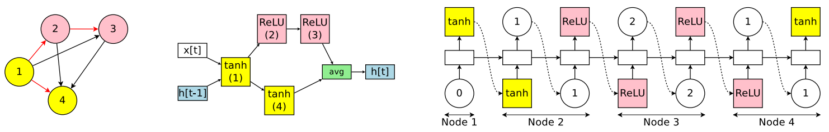
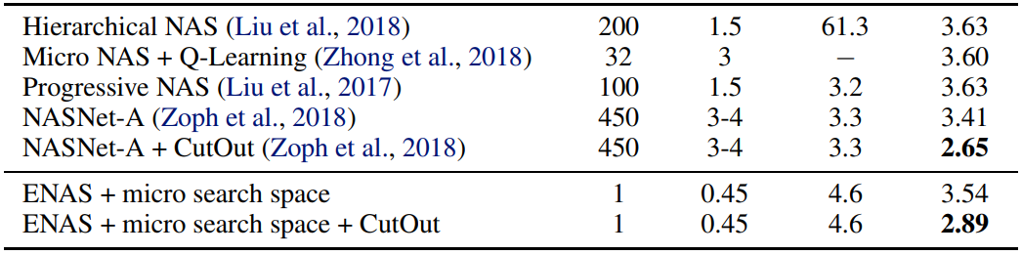
NAS with RL - Weight Sharing Mechanism (Pham et al. ICML’18)
hyper-graph (DAG)
RNN cell
sampling by Controller
low computing cost in practice

Slide 16
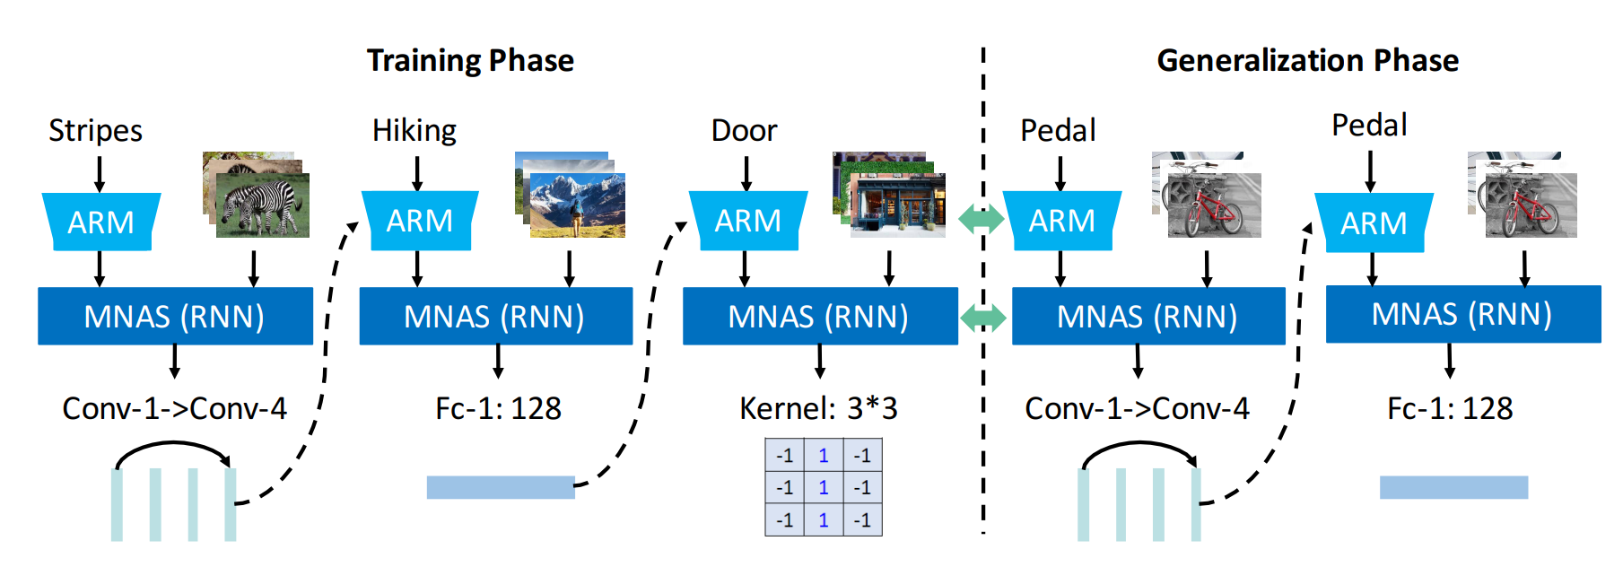
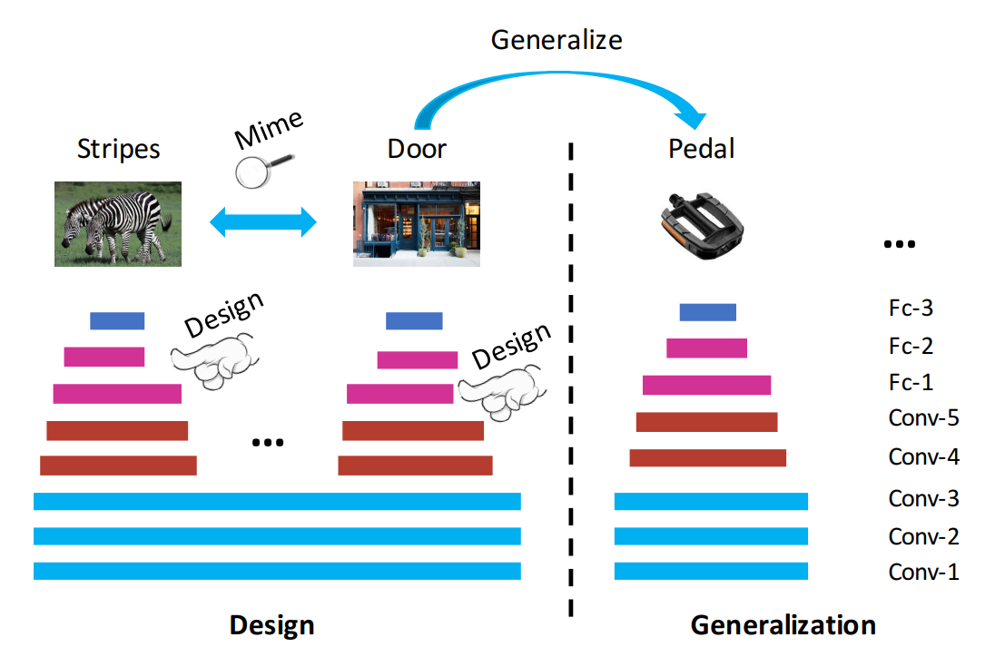
NAS with RL - Our work: Adaptive Cross-Domain NAS (Cheng et al. ACM MM’18)
New task: Generalize NAS strategies between domains
Generalize strategy to unseen domains
Generalizable NAS
Attribute guided NAS strategy

Slide 17
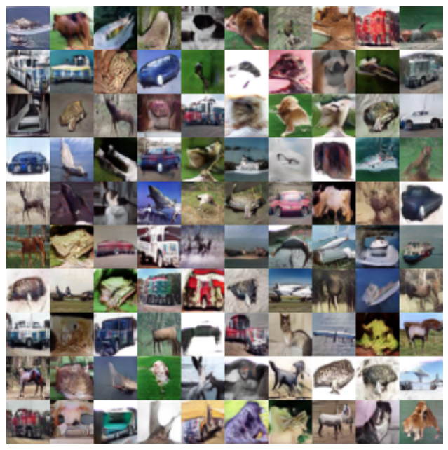
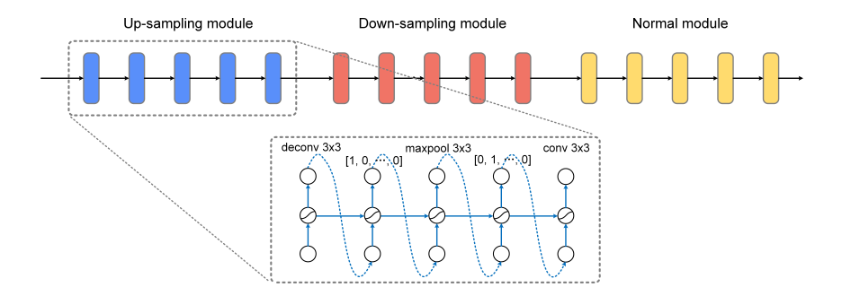
NAS with RL - Our work: A-GAN (Tech Report)
Searching for Architecture of Generative Model
Up-sampling module is rarely studied in NAS

Slide 18
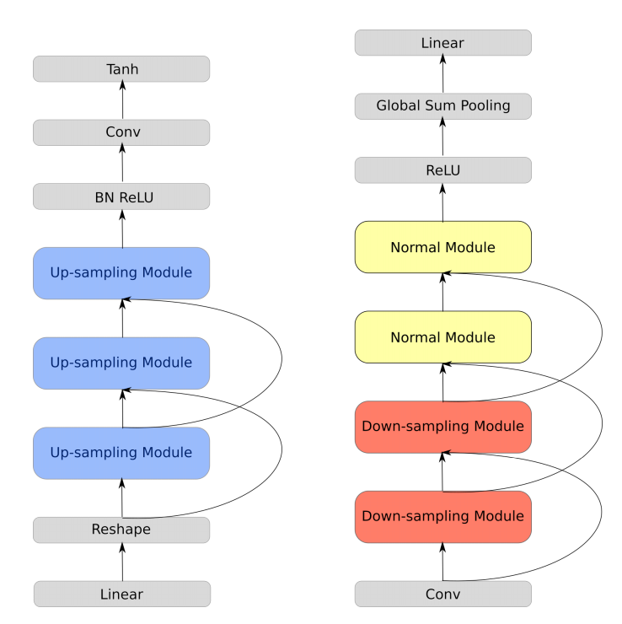
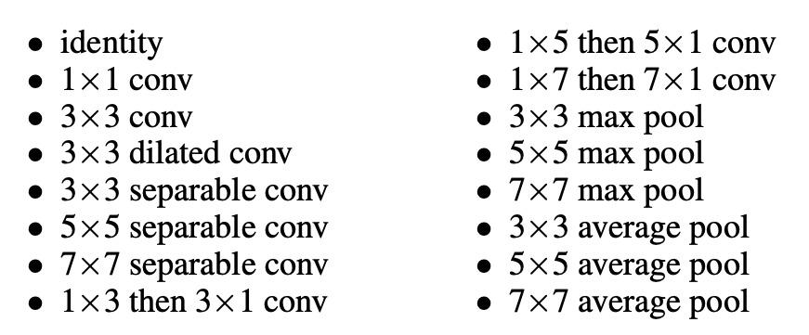
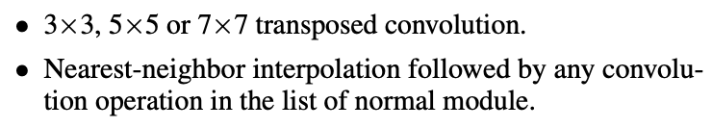
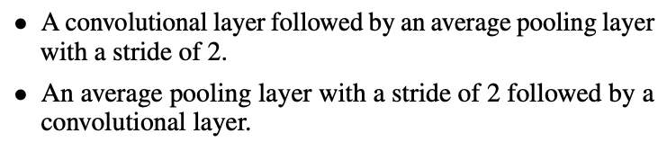
NAS with RL - Our work: A-GAN (Tech Report)
Search Space

Slide 19
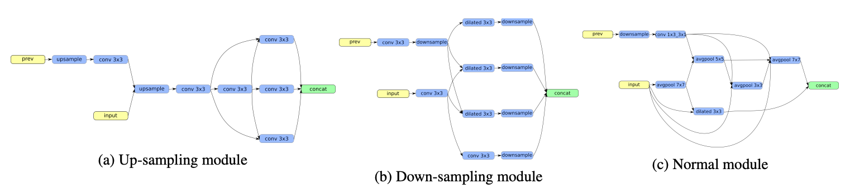
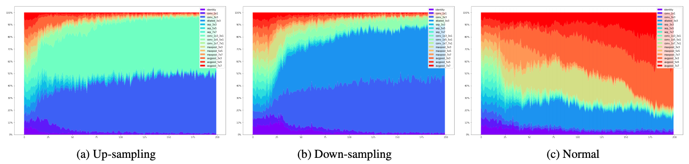
NAS with RL - Our work: A-GAN (Tech Report)
Avgpool 7x7
Conv 1x3, 3x1
Dilated Conv 3x3
Avgpool 5x5
Conv 3x3
Conv 3x3
Dilated Conv 3x3

Slide 20
Goal: A Brief Overview of NAS
AutoDL and NAS
NAS with RL
NAS with RL
NAS-Net
Weight sharing mechanism
Our work: Adaptive cross-domain NAS
Our work: AutoGAN
Differentiable NAS
Architecture embedding method
Continuous relaxation of discrete architecture
Our work: NAS-based state-of-the-art image classification model
Our work: Resource-customized NAS
Greedy NAS
Our work: NAS for tree-topology network

Slide 21
Differentiable NAS
Gradient-based
Policy gradient
RL
∂ performance
∂ arch
continuous relaxation
DARTS
arch embedding
NAO

Slide 22
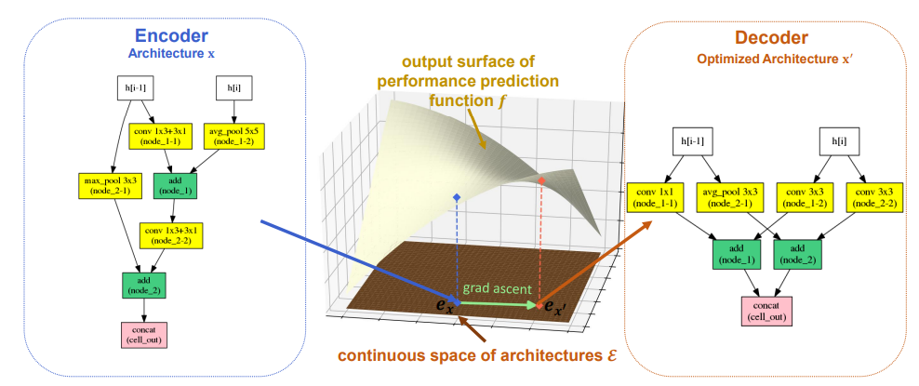
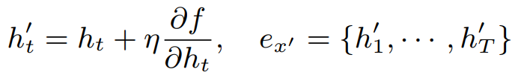
Differentiable NAS - Architecture Embedding (Luo et al. NIPS’18)

Slide 23
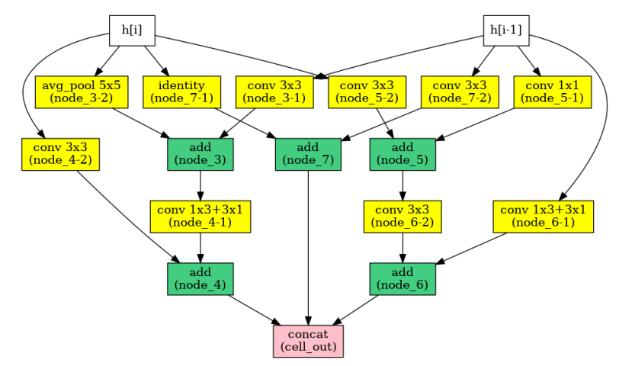
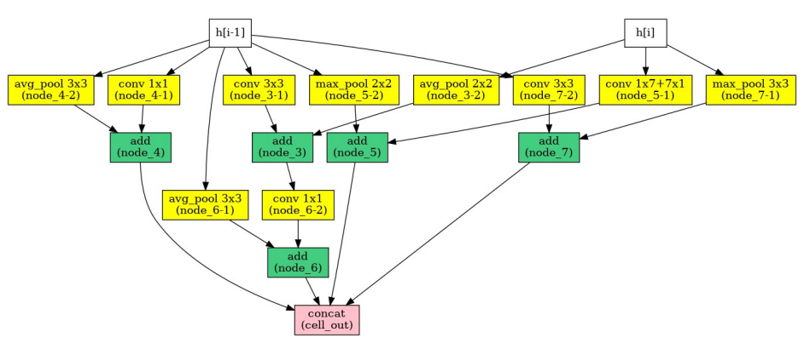
Differentiable NAS - Architecture Embedding (Luo et al. NIPS’18)
Performance prediction error of arch x
Reconstruction error of arch x
Normal Cell
Reduction Cell

Slide 24
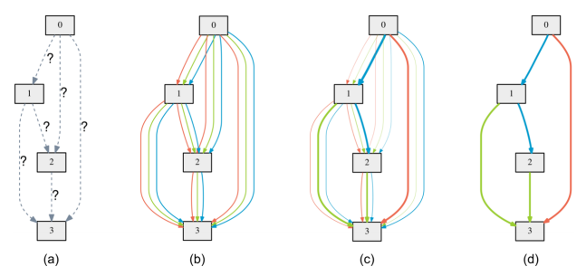
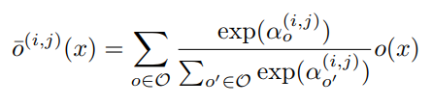
Differentiable NAS - DARTS: Contionuous Relaxation of Architecture (Liu et al. ICLR’19)
Continuous relaxation
of discrete operations

Slide 25
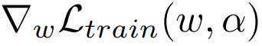
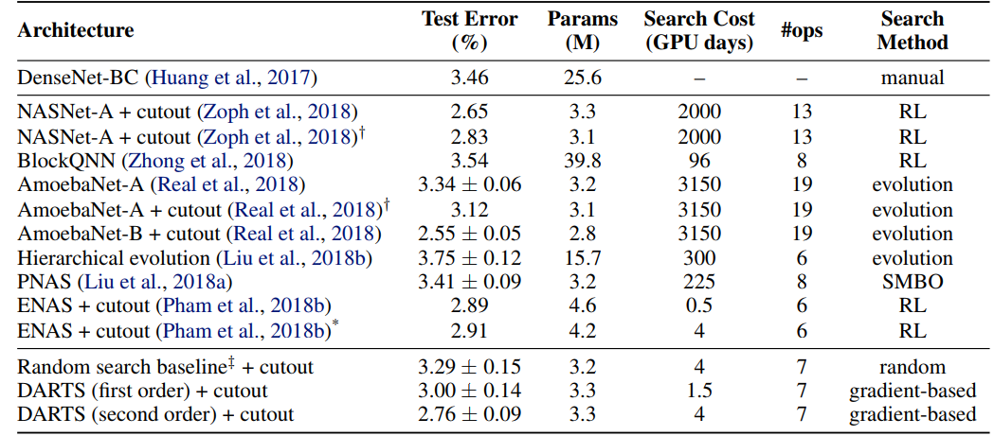
Differentiable NAS - DARTS (Liu et al. ICLR’19)
DARTS Algorithm— Update arch and weights alternately
Update arch on validation set
Update weights on training set
Low computing cost
Liu et al. ICLR’19

Slide 26
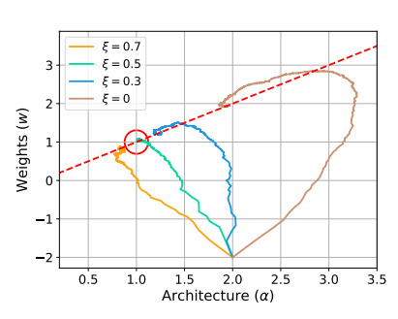
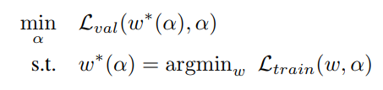
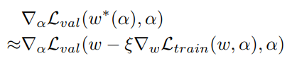
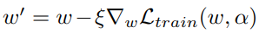
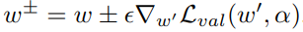
Differentiable NAS - Optimization in DARTS (Liu et al. ICLR’19)
1. Objective
2. One-step optimum of w*
3. Chain-Rule
4. Finite-Difference Approximation

Slide 27
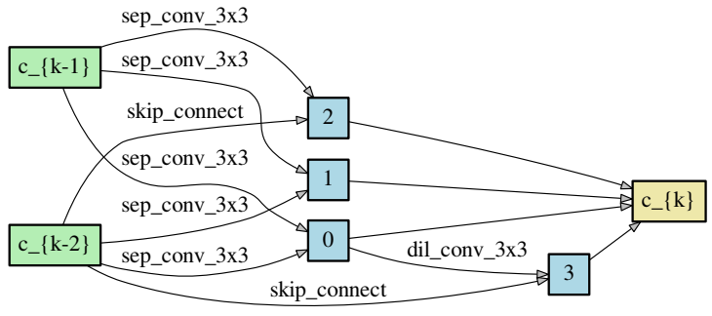
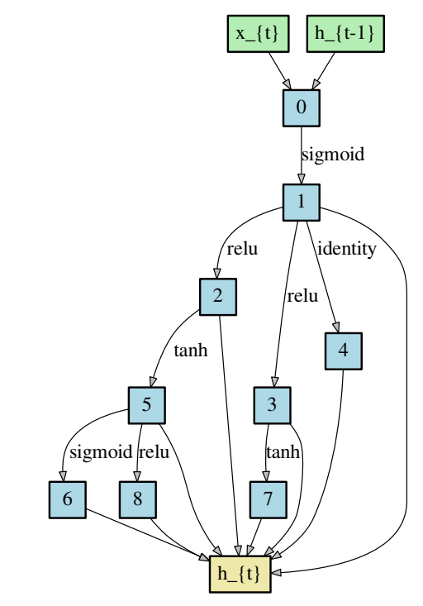
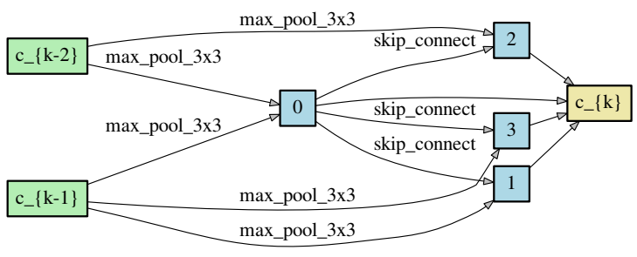
Differentiable NAS - Architectures Discovered by DARTS (Liu et al. ICLR’19)
Normal Cell
Reduction Cell
Recurrent Cell

Slide 28
Differentiable NAS - Our Work: State-of-the-Art Cifar-10 Model (Tech Report)
Based on Differentiable NAS
98.01% accuracy on CIFAR-10 (with normal data augmentations)
Model | Acc. | Model | Acc.
vgg_15_BN_64 | 93.0 | densenet_BC_100_12 | 95.5
vgg_16 | 93.6 | resnext_29_8x64d | 96.2
resnet_32 | 92.5 | DARC | 96.6
resnet_44 | 93.0 | shake_shake_64d_cutout | 97.1
resnet_56 | 93.3 | NAS | 95.4
resnet_110 | 93.5 | AdaNet | 97.6
wide_resnet | 95.0 | AutoDL | 98.0

Slide 29
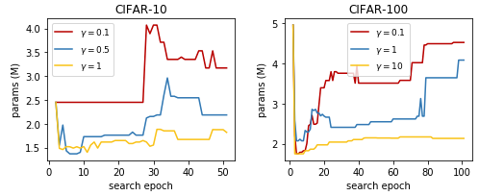
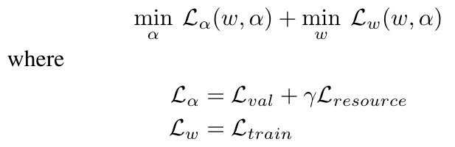
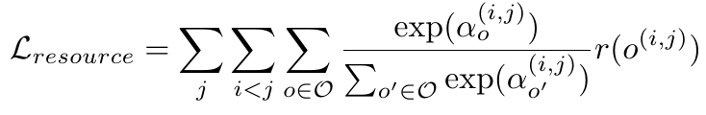
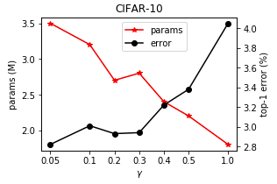
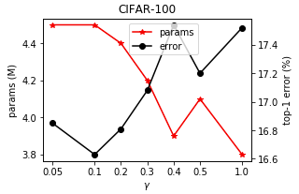
Differentiable NAS - Our Work: Resource-Customized Differentiable NAS (Tech Report)
Arch Params vs. Search Epochs
Optimization Under Resource Constraint
Params/Test Errors vs. γ
Resource Constraint

Slide 30
Goal: A Brief Overview of NAS
AutoDL and NAS
NAS with RL
NAS with RL
NAS-Net
Weight sharing mechanism
Our work: Adaptive cross-domain NAS
Our work: AutoGAN
Differentiable NAS
Architecture embedding method
Continuous relaxation of discrete architecture
Our work: NAS-based state-of-the-art image classification model
Our work: Resource-customized NAS
Greedy NAS
Our work: NAS for tree-topology network

Slide 31
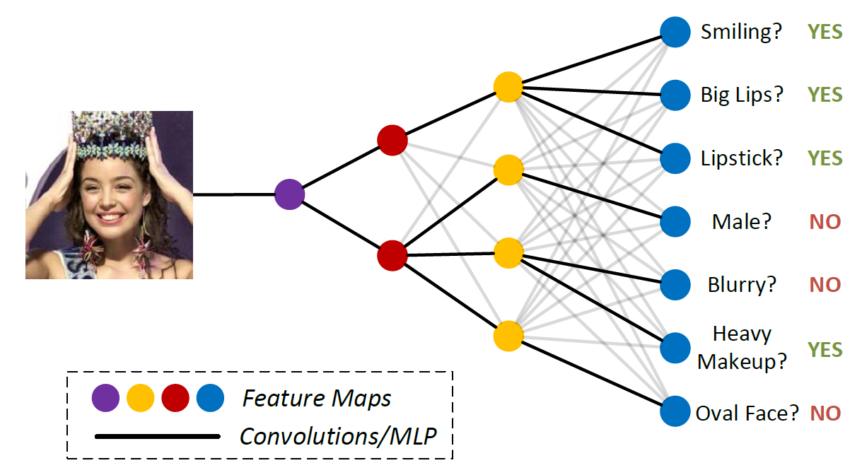
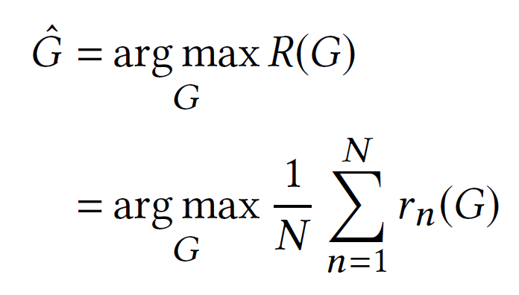
Greedy NAS - Our Work: NAS for Tree-Topology Network (Huang et al. ACM MM’18)
Multi-Attribute (Multi-Task) Learning
Attributes share representations via tree-topology

Slide 32
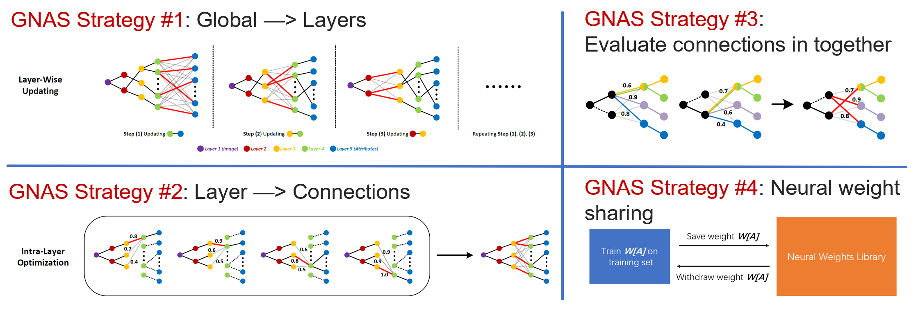
Greedy NAS - Our Work: NAS for Tree-Topology Network (Huang et al. ACM MM’18)
Integrating Different Greedy Strategies
Idea: Divide-and-Conquer the Search Space

Slide 33
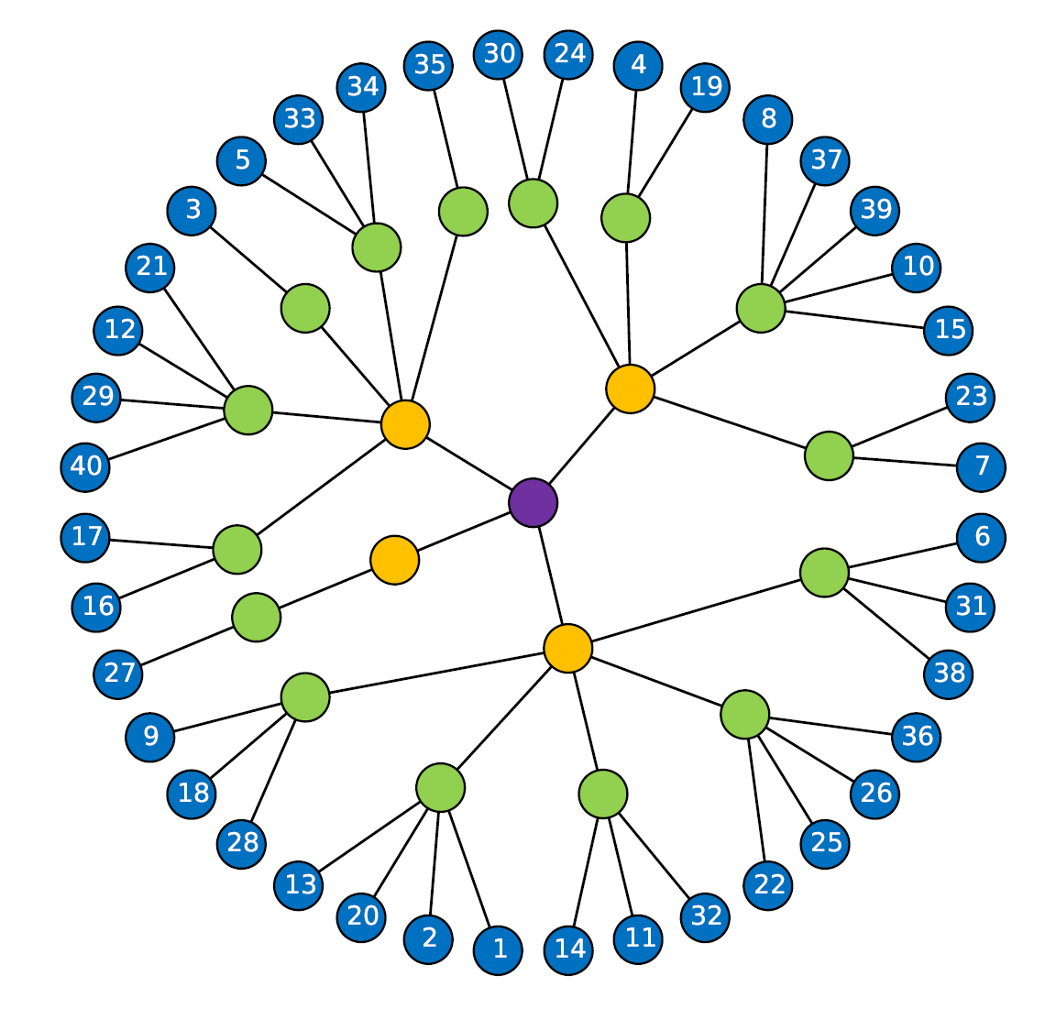
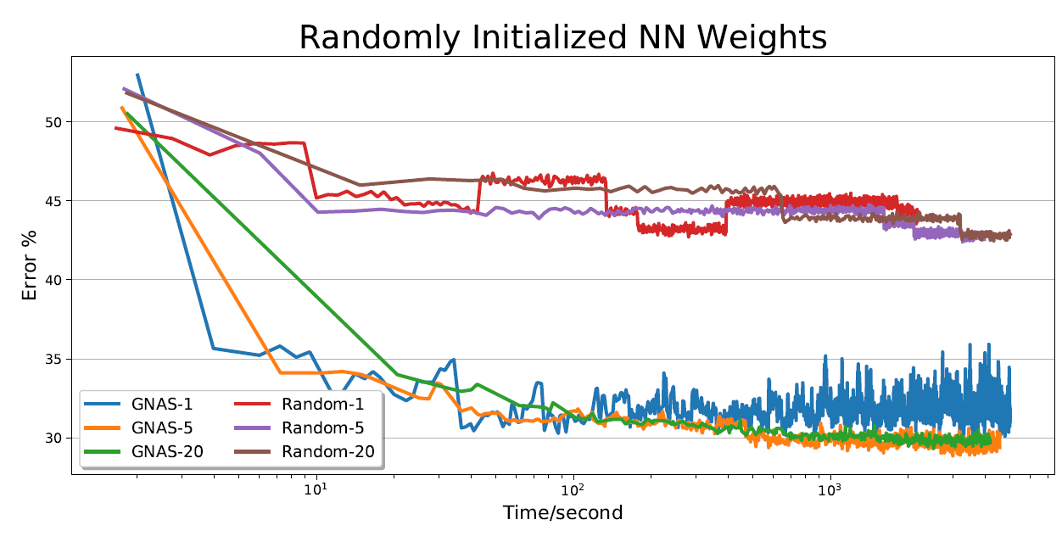

Greedy NAS - Our Work: NAS for Tree-Topology Network (Huang et al. ACM MM’18)
Tree-Topology—Reasonable Hierarchical Grouping of Attributes
Search Cost
1 GPU * 1 day on LFWA (6,000 images)
on Market-1501 (17,000 images)
1 GPU * 2 days on CelebA (180,000 images)
Significantly better than random search

Slide 34
References
1. B Zoph and QV Le. Neural Architecture Search with Reinforcement Learning. In ICLR, 2017.
2. B Zoph et al. Learning Transferable Architectures for Scalable Image Recognition. In CVPR, 2018.
3. H Pham et al. Efficient Neural Architecture Search via Parameter Sharing. In ICML, 2018.
4. Z Cheng et al. Learning to Transfer: Generalizable Attribute Learning with Multitask Neural Model Search. In ACM MM, 2018.
5. Wang H, Huan J. AGAN: Towards Automated Design of Generative Adversarial Networks. arXiv:1906.11080, 2019.
6. R Luo et al. Neural Architecture Optimization. In NIPS, 2018.
7. H Liu et al. Darts: Differentiable Architecture Search. In ICLR, 2019
8. S Huang et al. GNAS: A Greedy Neural Architecture Search Method for Multi-Attribute Learning. In ACM MM, 2018.
Dr. Siyu Huang
Baidu Research
huangsiyu@baidu.com
Homepage: https://siyuhuang.github.io/

